Slide 1
Computer Graphics: Rendering
Lecture 5: Modelling
Kartic Subr

Slide 2

What is a model?

Slide 3
What is a model?
use (a system, procedure, etc.) as an example to follow or imitate.

Slide 4
materials
animation
lighting
geometry
textures

Slide 5
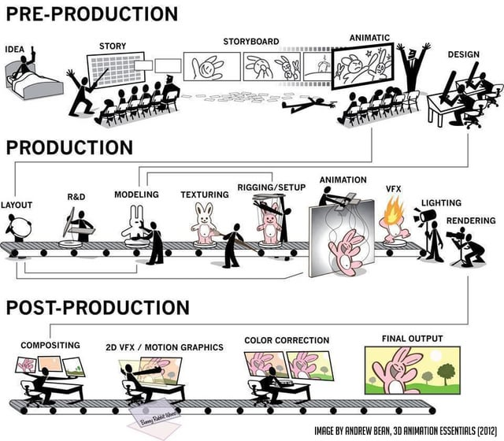

Slide 6
Search videos showing ‘effects breakdown’
https://www.youtube.com/watch?v=pTffQIFFYR8

Slide 7
Approaches to modelling
Artistic creation
maths
measurement

Slide 8
Approaches to modelling
Artistic creation
maths
measurement
Use physics
Repeated procedure
Analytical shapes (sphere)
3D scan
Photograph
Motion capture

Slide 9
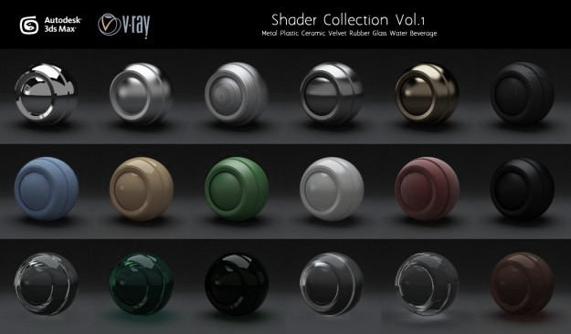
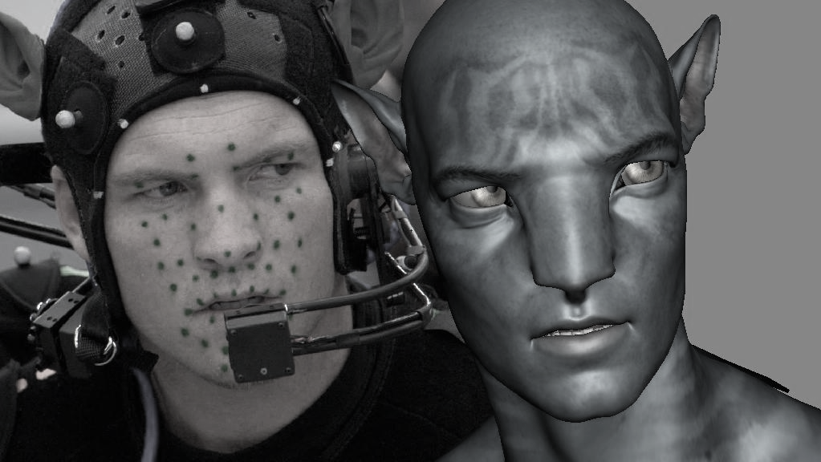

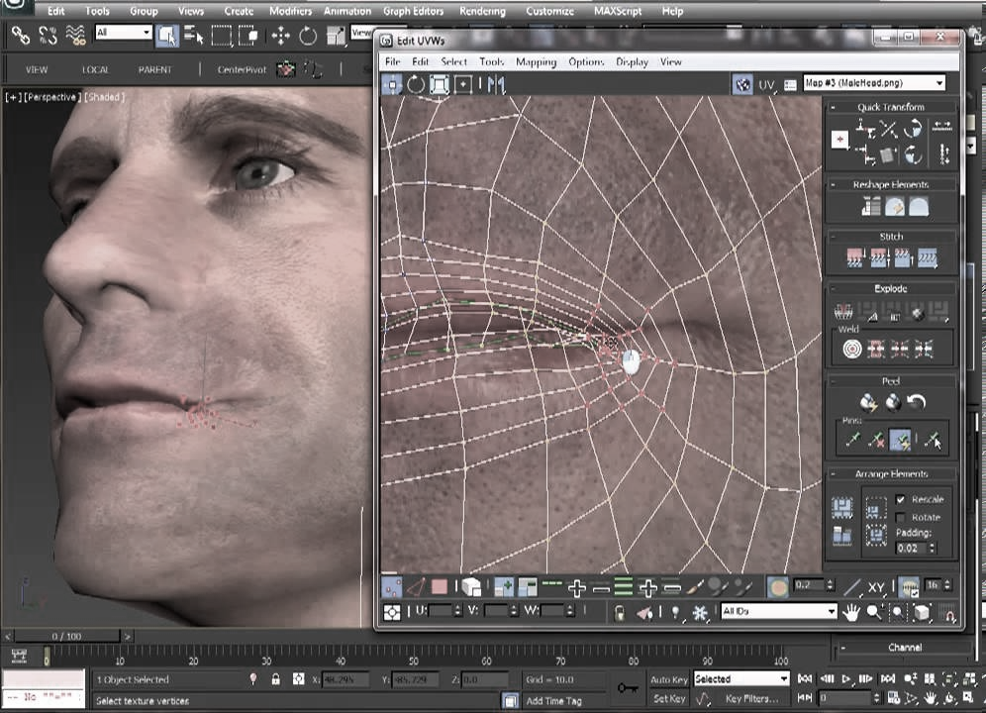
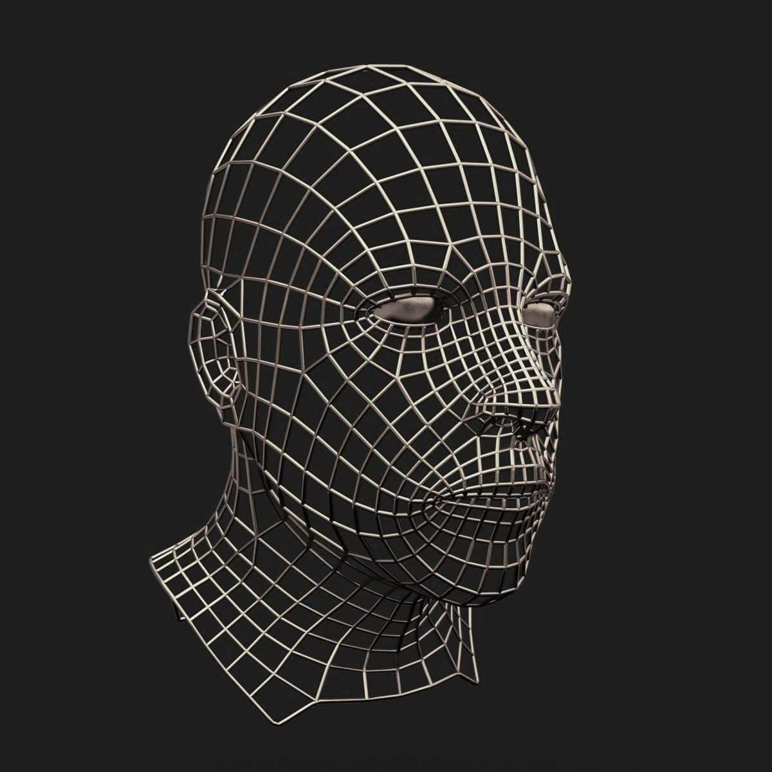
manually created models
artistic expression

Slide 11
measurement

Slide 13
mathematical models

Slide 14
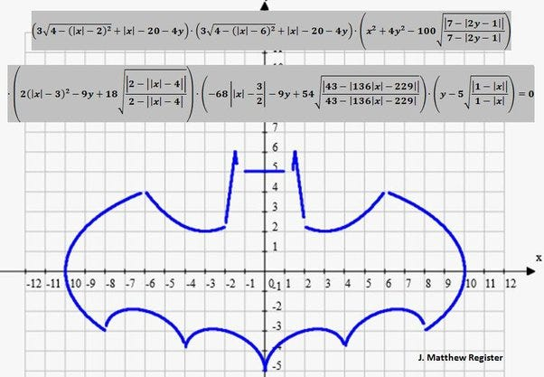
mathematical models

Slide 15

3D shape representations

Slide 16
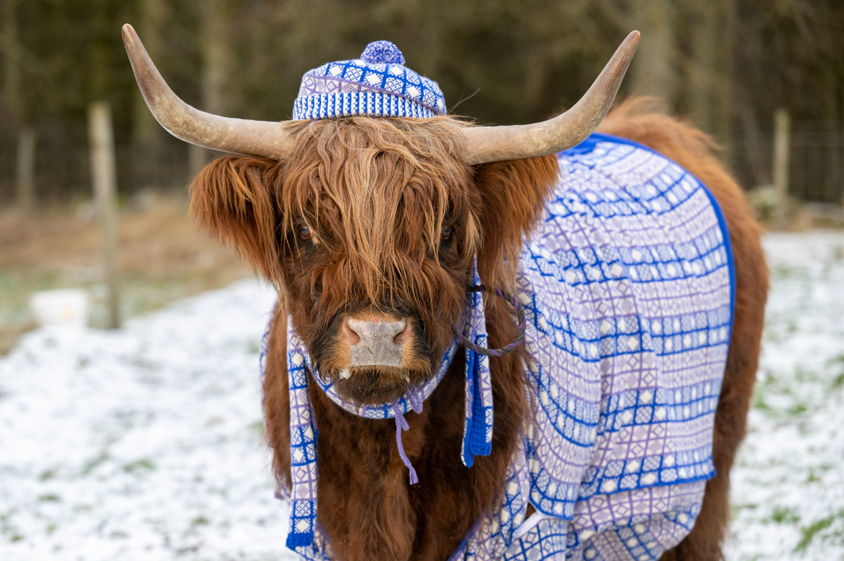
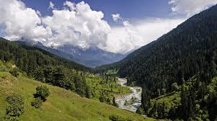
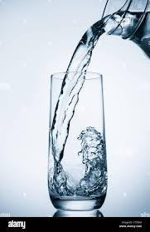

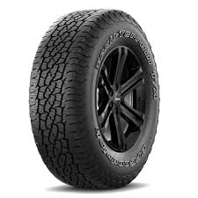
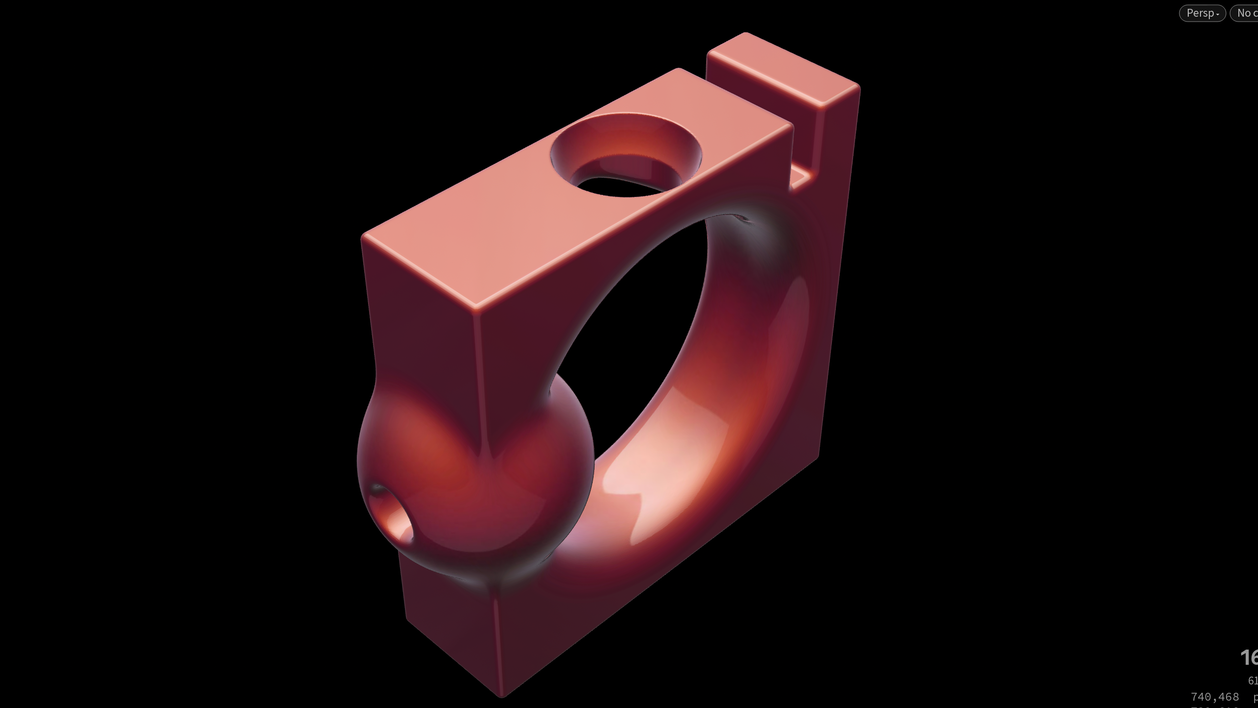
3D shape representations

Slide 17

3D shape representations

Slide 18
3D shape representations
Implicit representation
Explicit representations
primitives
parametric

Slide 19
3D modelling – common approaches
constructive solid geometry
parametric surfaces
procedural modelling
https://www.cs.cmu.edu/~scoros/cs15869-s15/lectures/05-CSG_Procedural.pdf
http://www.inf.ed.ac.uk/teaching/courses/cg/lectures/slides16.pdf
https://www.cs.princeton.edu/courses/archive/spring03/cs426/lectures/16-procedural.pdf

Slide 20
Materials – common approaches
measured
parametric e.g. ggx, bssrdf
procedural modelling
more about this, later in the course …

Slide 21
Lighting

